Slide 1
What does it mean to plagiarize?

Slide 2
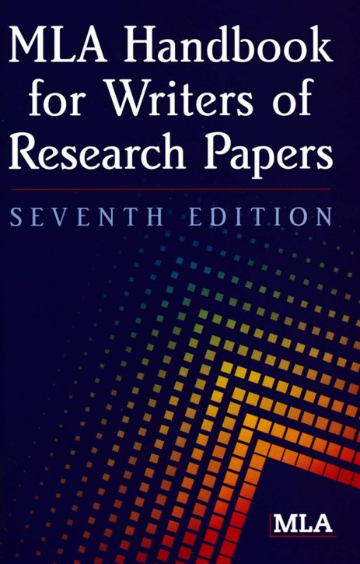
What is MLA?
Stands for Modern Langauge Association
A group of smart people who decided what the rules of formatting and citing should be

Slide 3
Formatting
How a paper looks
(spacing, heading, etc)

Slide 4
Citing
How a paper shows it borrows from another work
Citations
Works Cited Page

Slide 5
Other Research Tidbits you should know
Google isn’t a source
Wikipedia isn’t a reliable source

Slide 6
Trusted Websites
.edu= stands for education
.org= stands for organization
.gov= stands for government
Not Trusted
.com= stands for company
Why would you not trust a .com?

Slide 7
Even if you cite something, you can’t plagiarize it.
Plagiarizing is copying someone else’s work
Citing is not permission to plagiarize
If you copy anything- it needs to be in quotes
‘’Something from another text”

Slide 8
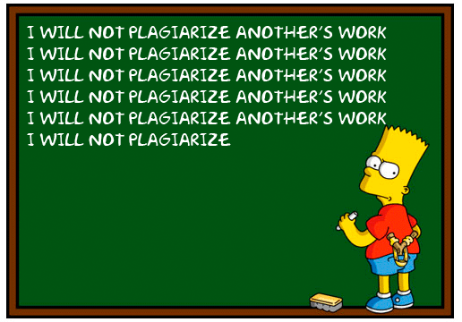
What happens to me if I plagiarize?
You have copied someone else’s work without permission
You have become a theft
You can be expelled from most universities
DON’T PLAGIARIZE!

Slide 9
As a group, reflect on the bottom of your worksheet.
Why do we need MLA?

